Slide 1
Evaluation of AODV, DSR and DSDV Routing Protocols using NS2 Simulator
Group Member: Weidong Guo, Yuxiang Liu, Chiyao Shen, Yue Li, Shujun Bian

Slide 2
Outline
Introduction
AODV, DSR and DSDV Protocols
NS-2 Simulator
Experiment Approach
Main Results
Analysis and Conclusion

Slide 3
Introduction
Wireless ad-hoc network (WANET)
Mobile ad-hoc networks (MANET)
Ad hoc On-Demand Distance Vector (AODV) Routing
Dynamic Source Routing (DSR)
Destination -Sequenced Distance-Vector (DSDV) Routing
NS-2 simulator

Slide 4
AODV Protocol
Sender tries to find destination:
broadcasts a Route Request Packet (RREQ).
Nodes maintain route cache and use destination sequence number for each route entry
State is installed at nodes per destination
Does nothing when connection between end points is still valid
When route fails
Local recovery
Sender repeats a Route Discovery

Slide 5
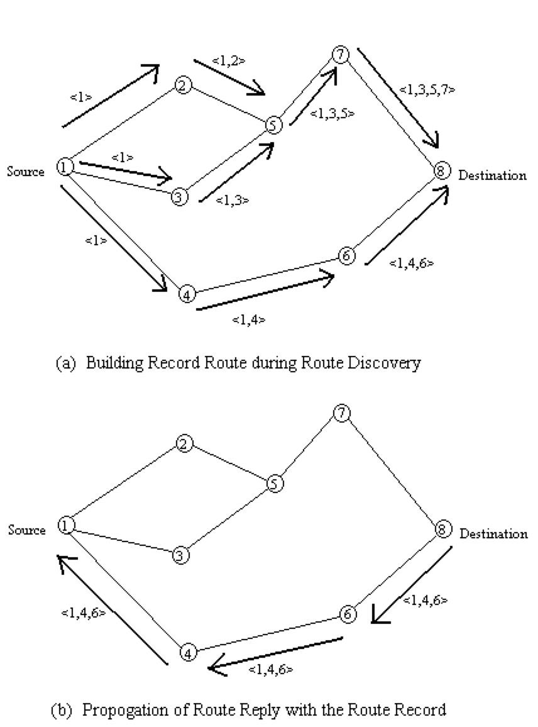
DSR Protocol
Two mechanisms: Route Maintenance and Route Discovery
Route Discovery mechanism is similar to the one in AODV but with source routing instead
Nodes maintain route caches
Entries in route caches are updated as nodes learn new routes.
Packet send carries complete, ordered list of nodes through which packet will pass
When sending the packets:
Sender checks its route cache, if route exists, sender constructs a source route in the packet’s header
If route expires or does not exist, sender initiates the Route Discovery Mechanism

Slide 6

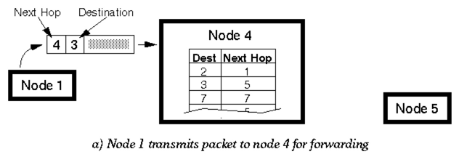
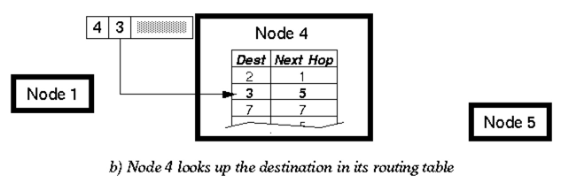
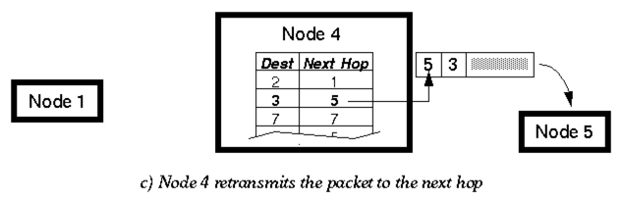
DSDV Protocol
DSDV is Proactive (Table Driven)
Each node maintains routing information for all known destinations
Routing information must be updated periodically
Traffic overhead even if there is no change in network topology
Maintains routes which are never used
Keep the simplicity of Distance Vector
Guarantee Loop Freeness
New Table Entry for Destination Sequence Number
Allow fast reaction to topology changes
Make immediate route advertisement on significant changes in routing table
but wait with advertising of unstable routes (damping fluctuations)

Slide 7
NS-2 Simulator
NS-2 is a discrete event simulator targeted at networking research. Ns provides substantial support for simulation of TCP, routing, and multicast protocols over wired and wireless (local and satellite) networks.

Slide 8
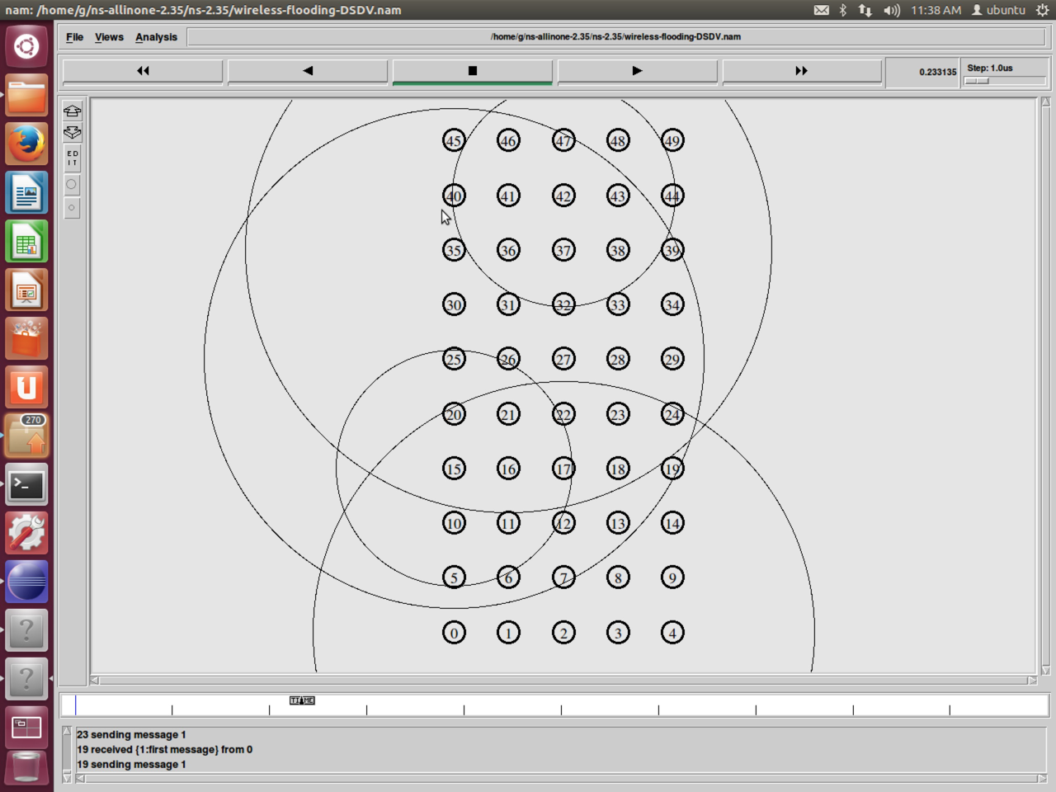
Experiment Approach
1. Install NS-2.34
2. Install Eclipse and CDT plugin
3. Modify configuration files and put the whole source code into Eclipse as a C++ project
4. Modify tcl files to deploy nodes, set environment, set protocols and set trace file.
5. Use nam to visualize the process of the experiment.
6. Analyze the generated trace files and extract useful data from them.

Slide 9
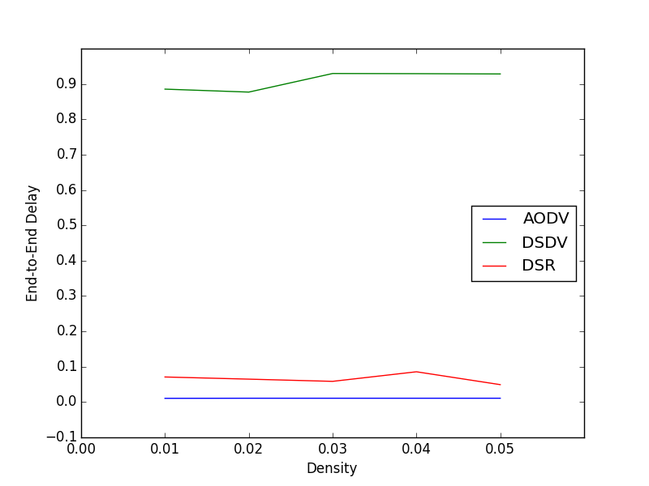
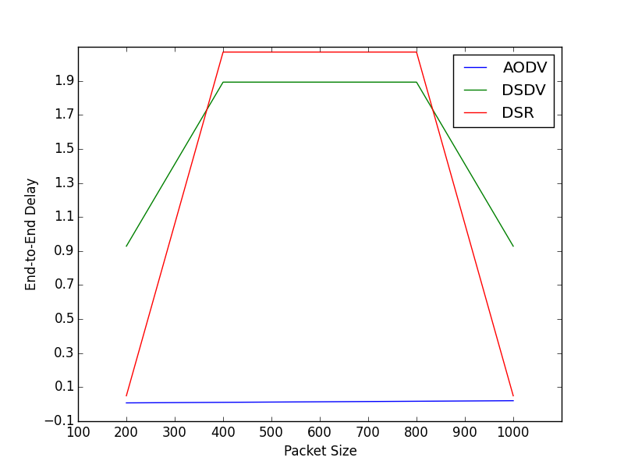
Main Results - Delay
AODV performance is the best considering its ability to maintain connection by periodic exchange of data’s.

Slide 10
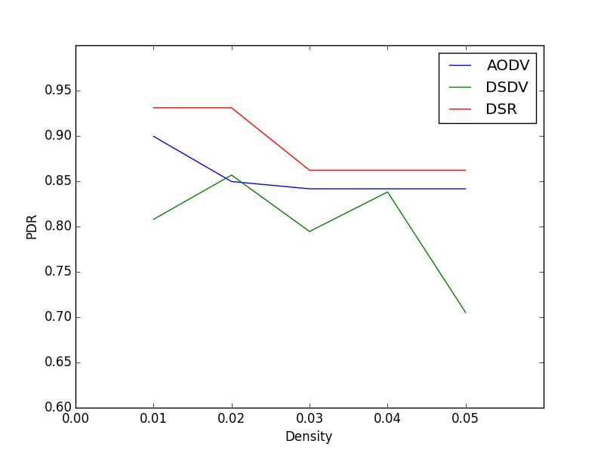
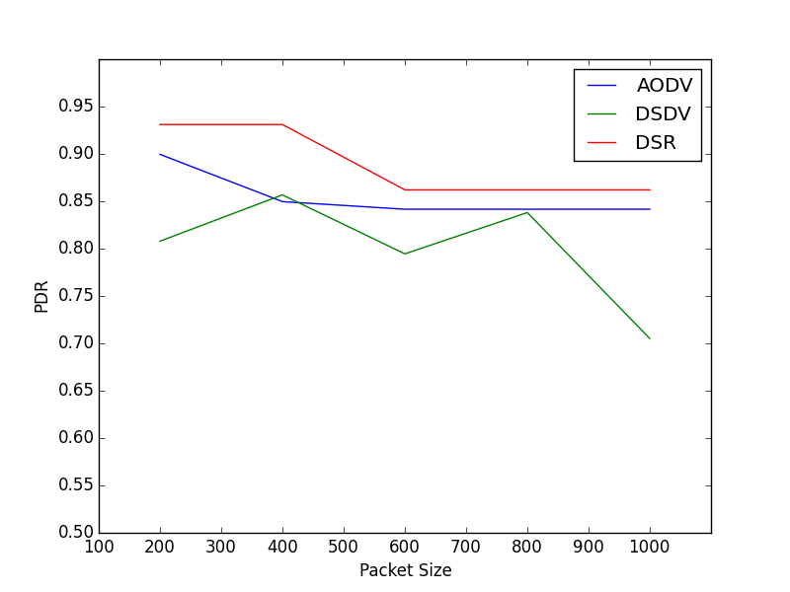
Main Results - Packets Delivery Rate
As it can be seen from the above results ,Table driven routing protocol(DSDV) has lower pdr than reactive protocols(AODV,DSR). Among these three protocols DSR is better pdr than AODV and DSDV.

Slide 11
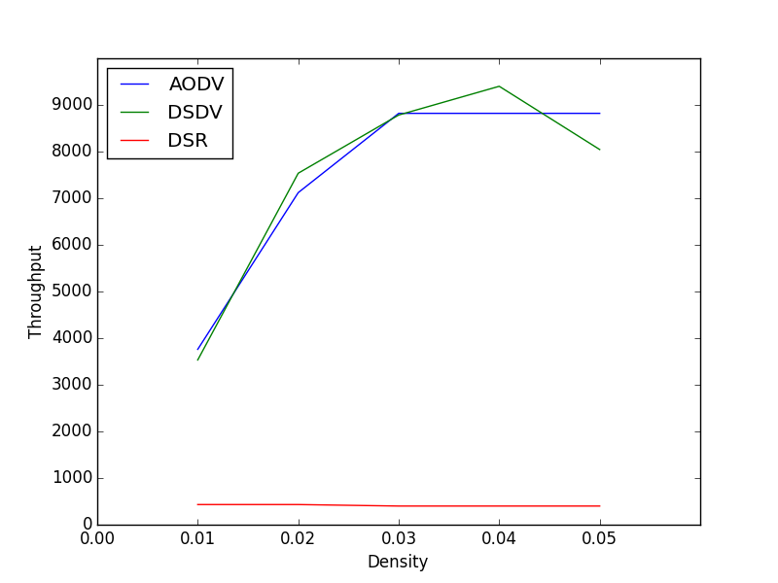
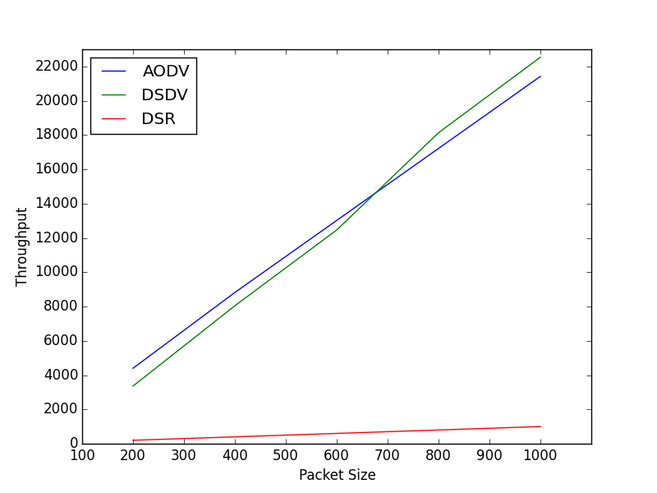
Main Results - Throughput
DSDV is huge control overhead because its periodic routing table updates in the network. Then AODV is slightly lower than the DSDV and DSR have lower control overhead then two other routing protocols.

Slide 12
Analysis and Conclusion - AODV
Advantage:
The main advantage of this protocol is that routes are established on demand and destination sequence numbers are used to find the latest route to destination. The connection setup delay is less.
Disadvantage:
One disadvantage is that intermediate nodes can lead to inconsistent routes if the source sequence number is very old and the intermediate nodes have a higher but not the latest destination sequence number, thereby having stale entries. Also multiple Route Request packets in response to a single Route Request packet can lead to heavy control overhead.

Slide 13
Analysis and Conclusion - DSR
Advantage:
This protocol used a reactive approach which eliminates the need to periodically flood the network with table update messages which are in table-driven approach. The intermediate nodes also utilize the route cache information efficiently to reduce the control overhead.
Disadvantage:
The route maintenance mechanism does not locally repair a broken link. Stale route cache information could also result in inconsistencies during the route reconstruction phase.

Slide 14
Analysis and Conclusion - DSDV
Advantages:
Simple (almost like Distance Vector)
Loop free through destination seq. numbers
No latency caused by route discovery
Disadvantages:
No sleeping nodes
Overhead: most routing information never used

Slide 15
References
Mohapatra, S., and P. Kanungo. "Performance analysis of AODV, DSR, OLSR and DSDV routing protocols using NS2 Simulator." Procedia Engineering 30 (2012): 69-76.
http://www.ijarcce.com/upload/2013/december/IJARCCE2C-rajesh_COMPARATIVE-FINAL.pdf
http://www.cse.wustl.edu/~jain/cis788-99/ftp/adhoc_routing/
http://ghost.lesiuk.org/AdHoc/adhoc/

Slide 16
That’s all :D Thank you~

